Slide 1
Zoom Recording using Samson Wireless Mic

Slide 2
Quick Video Instructions - http://i.sfu.ca/vUdDrd
Purpose
Allow instructors to record slides presentation/audio of a lecture. This is NOT intended for class participation in a zoom session
Prerequisites
* We strongly recommend performing a test recording prior to your first class *
MFA
Be Enrolled in the university Multi Factor Authentication, https://www.sfu.ca/information-systems/services/mfa.html
A SFU Zoom login
Do not use regular Zoom.us. You must use SFU Zoom, https://sfu.zoom.us. This is required to access the SFU-paid recording function in Zoom.
If you have not set up your SFU Zoom account pls follow this link: https://www.sfu.ca/information-systems/services/zoom/how-to-guides/zoom-meeting/get-started--sign-in.html
If using your laptop then the Zoom desktop application is recommended (link)
Zoom desktop is installed in all FHS managed teaching spaces in Blusson Hall; BLU 11660,11401,10401,9920,9011,9021
A SFU Zoom Meeting Room
Login SFU Zoom to create and enter meeting room https://www.sfu.ca/information-systems/services/zoom/how-to-guides/zoom-meeting/create-a-meeting.html#main_content_text
Samson XPD2 Lavalier USB Digital Wireless System
Ensure you have the USB Base, Wireless Microphone Transmitter and Microphone attachment
Knowledge on how to record a zoom session
https://www.sfu.ca/information-systems/services/zoom/how-to-guides/zoom-meeting/share-cloud-recordings-with-students.html

Slide 3
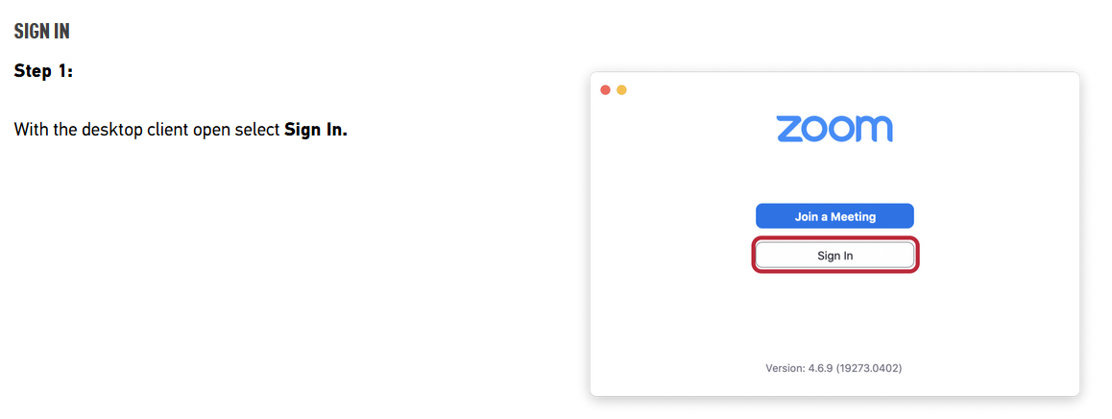
Step1 :Log onto Zoom Using Desktop Client

Slide 4
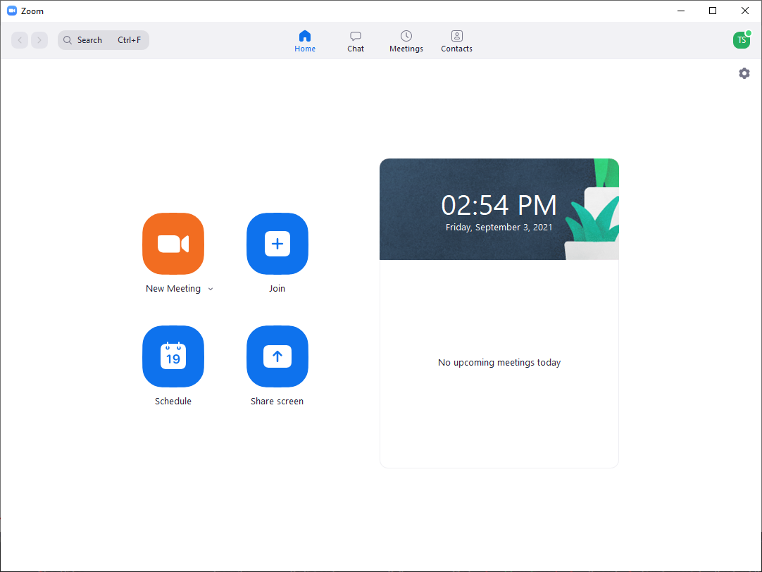
Step 2: Join Zoom Meeting
Click on New Meeting
Or join previously scheduled meeting (if applicable)
Upon joinging, a window will appear with a set of menu items at the bottom
Audio, Record and Share Screen are the features needed

Slide 5
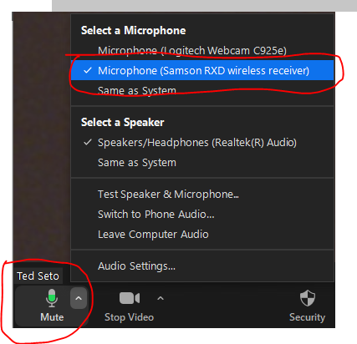
Step 3: Setting Up Wireless Mic and Zoom
Plug USB mic receiver into your presentation computer (if using classroom computer ensure you remove USB after the recording ends)
Connect Microphone attachment to transmitter and Power on, note batteries are need in the transmitter
The light on both the wireless transmitter and USB receiver should both be Orange
In Zoom ensure the Samson RXD wireless receiver is selected as the Microphone
Do a quick sound test, the mic should turn green in response to your voice

Slide 6
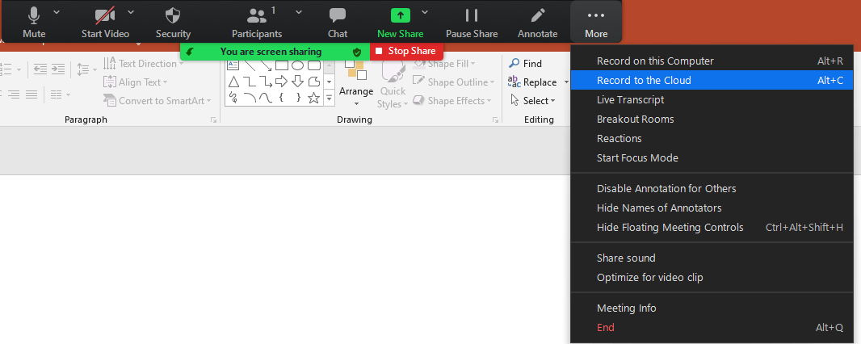
Step 4: Recording your class
When ready, select Record to the Cloud.
When finished, remember to click on Stop/End Record before signing off Zoom
The recording will be automatically saved to your SFU Zoom online account. You will not need to wait for or copy the recording from the computer.

Slide 7
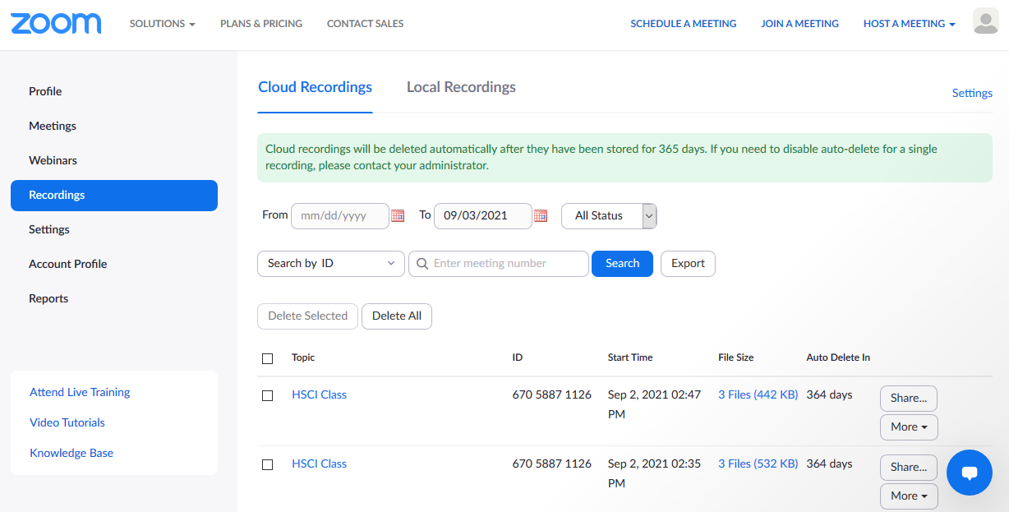
Step 5 – Obtaining Link to Distribute / Post on Canvas
Cloud Recordings are available in your SFU Zoom account at https://sfu.zoom.us
Locate recording you wish to post on Canvas and click on Share

Slide 8
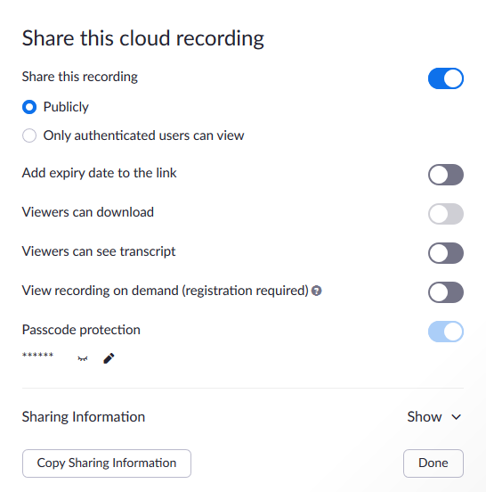
Step 5 – Obtaining Link to Distribute / Post on Canvas
Click on Copy Sharing Information or on Show to obtain link to recording
There are two access levels for your recording
Publicly – Anyone who has the link can view the recording
Only authenticated users can view - Link itself is not enough to view recording. Requires users to also sign into SFU Zoom in order to view link
To disable access to recording, toggle Share this recording to OFF

